Slide 1
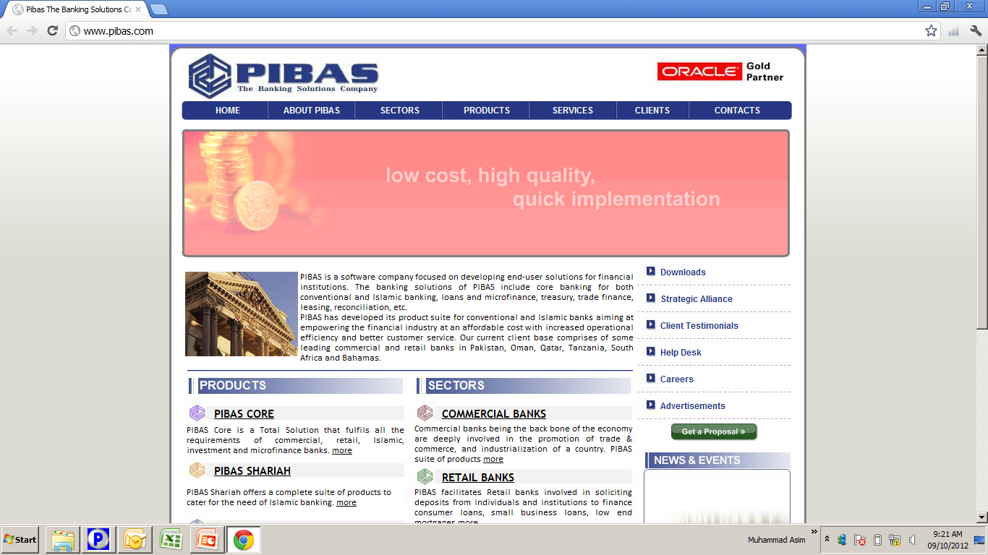
Centralized Limit Management
Centralized Limit Management
Important Note:
OIB Data along with Bin will be used for this training.

Slide 2
Contents
Centralized Limit Management
What is “Centralized Limits” (Definition)
Business Relation Limit Management
Business Relation Limit Supervision
Business Relation Inquiry
Centralized Limit Parameter Management
Credit Line Management
Centralized Limits Reports

Slide 3
Centralized Limit Management
What is “Centralized Limits”
(Definition)
Loan Limit: An approved amount of loan that can be withdrawn by a borrower
Account Level Limit: Loan Limit on a loan account
Application Level Limit: Loan Limits on different loan accounts under one BR
Centralized Limits: Enhanced version of Application Level Limit, wherein loan limits of borrowers are fed / updated / controlled / analyze by concerned persons of any lending institution. These limits are applied both on Funded Loan Facilities and Non-Funded Loan Facilities. Funded Facilities could be Term Loan, Running Finance and Consumer Financing etc. and Non-Funded Facilities could be Letter of Credit and Letter of Guarantee etc.

Slide 4
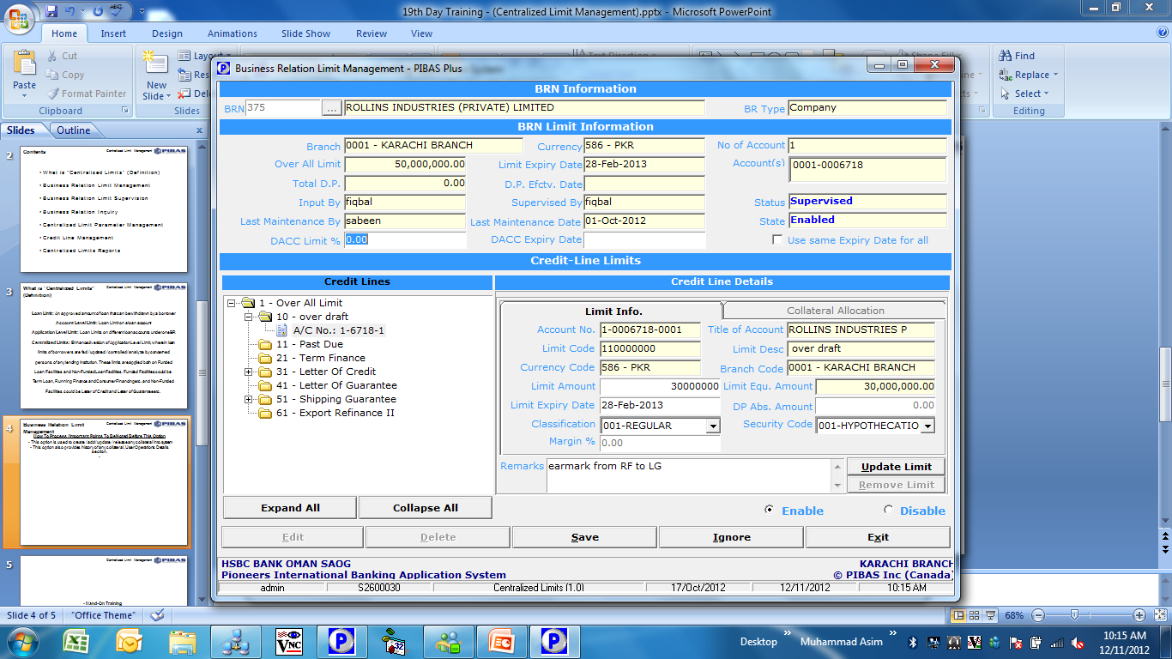
Centralized Limit Management
Business Relation Limit
Management
How To Process / Important Points To Be Noted Before This Option
Through this options, various types of limits could be assigned with details i.e. Start Date, End Date (expiry), Limit Amount, Margin% and Status (enabled / disabled) etc.

Slide 5
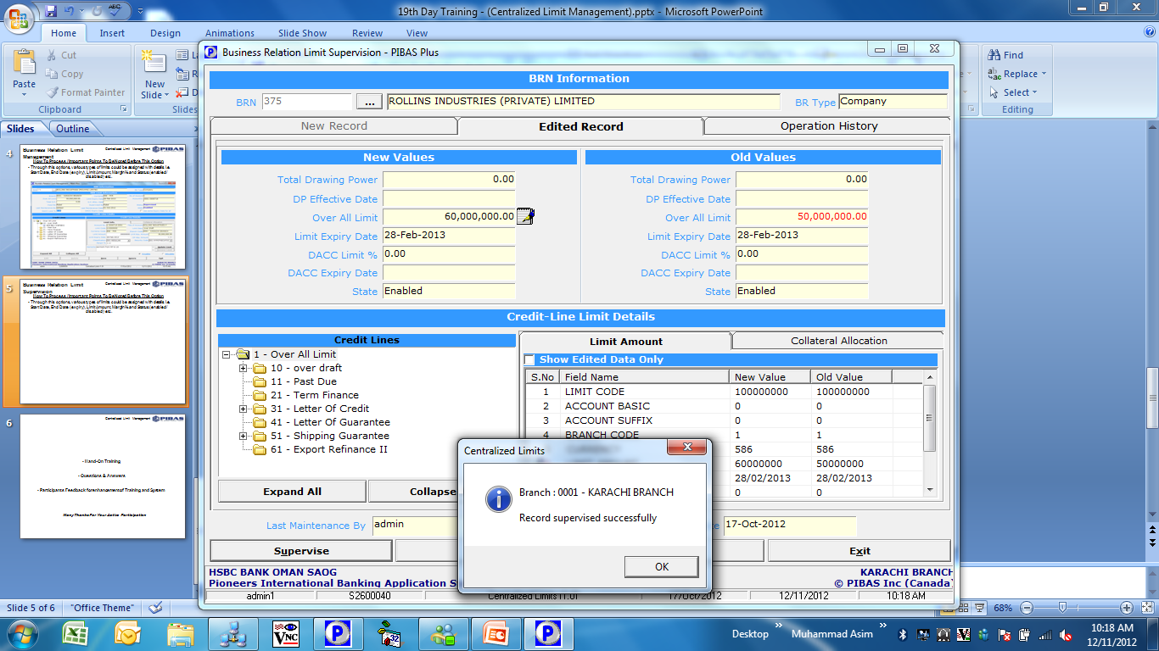
Centralized Limit Management
Business Relation Limit
Supervision
How To Process / Important Points To Be Noted Before This Option
Through this option, any changes could be supervised

Slide 6
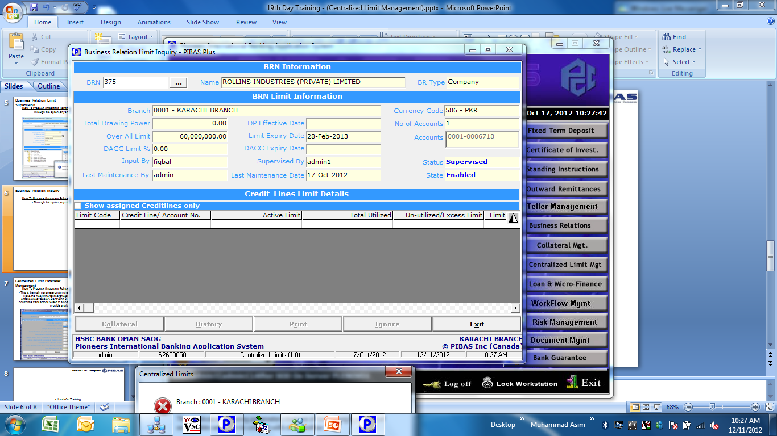
Centralized Limit Management
Business Relation Inquiry
How To Process / Important Points To Be Noted Before This Option
This option is used to view the detail of a borrower’s limit

Slide 7
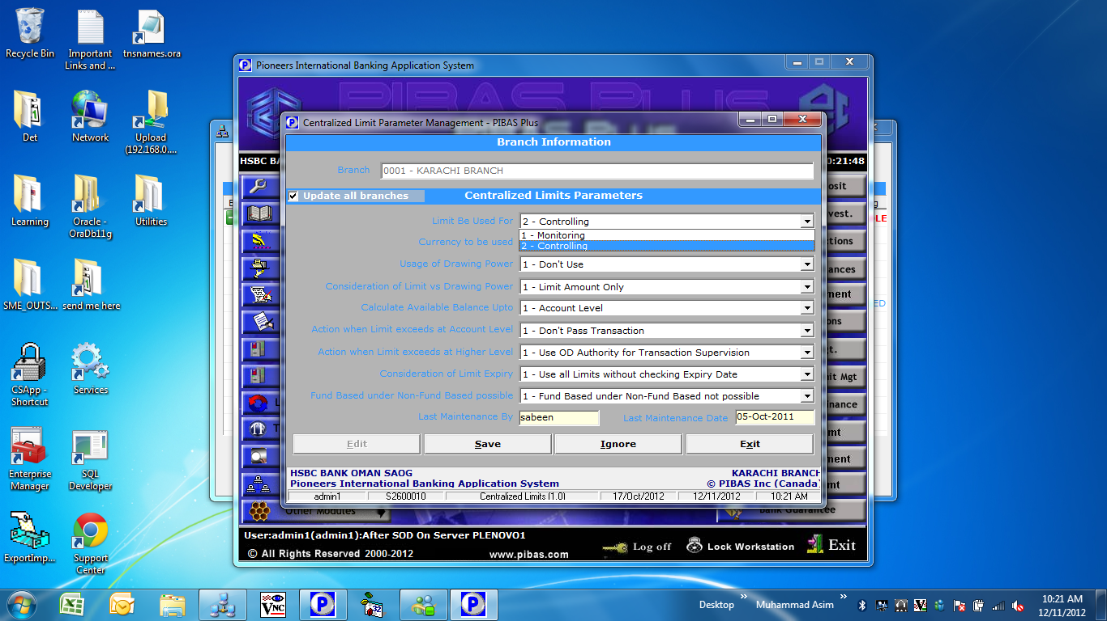
Centralized Limit Management
Centralized Limit Parameter
Management
How To Process / Important Points To Be Noted Before This Option
This is the main parameter option wherein different parameters could be set.
Here, the most important parameter is “Limit Be Used For”, wherein two options are available 1. Controlling 2. Monitoring. In Controlling system will control the transactions related to a borrower but in Monitoring system will only provide analysis / reports.

Slide 8
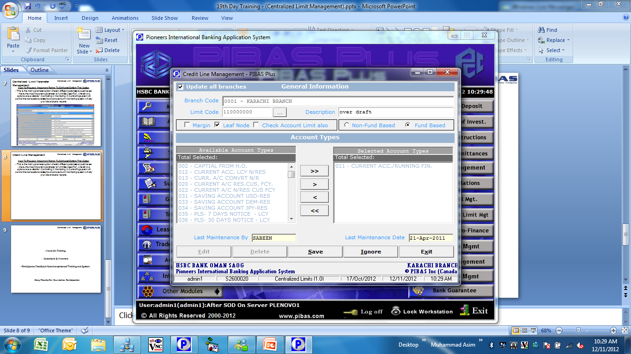
Centralized Limit Management
Credit Line Management
How To Process / Important Points To Be Noted Before This Option
Through this parameter option account types are set / linked to a specified limit type.

Slide 9
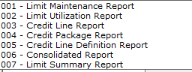
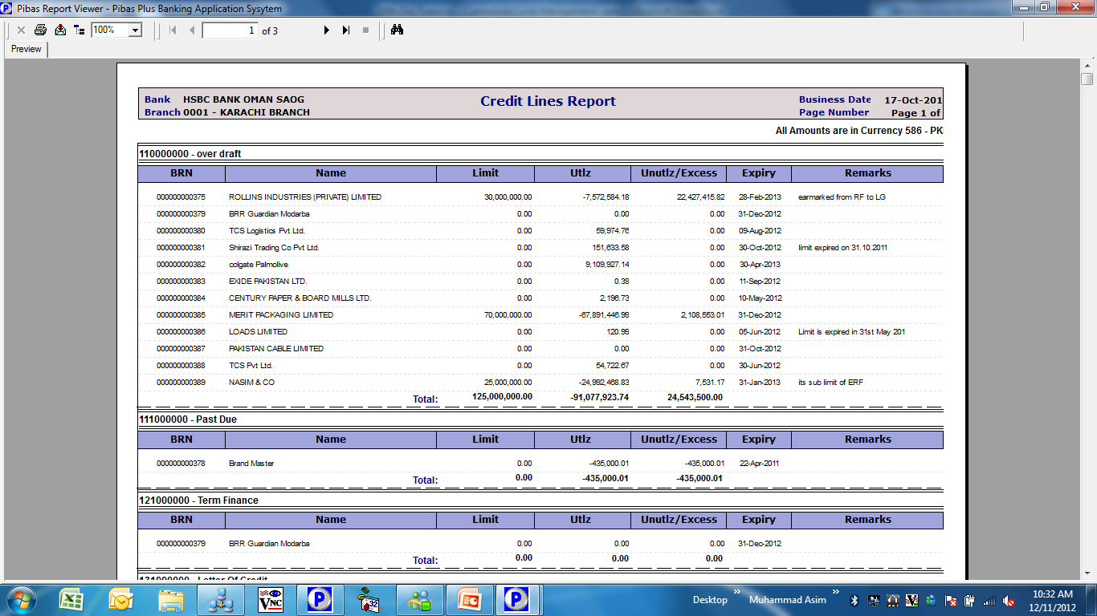
Centralized Limit Management
Centralized Limits Reports
How To Process / Important Points To Be Noted Before This Option
Presently, 7 different types of reports options are available

Slide 10
Centralized Limit Management
Hand-On Training
Questions & Answers
Participants Feedback for enhancement of Training and System
Many Thanks For Your Active Participation

